Slide 1
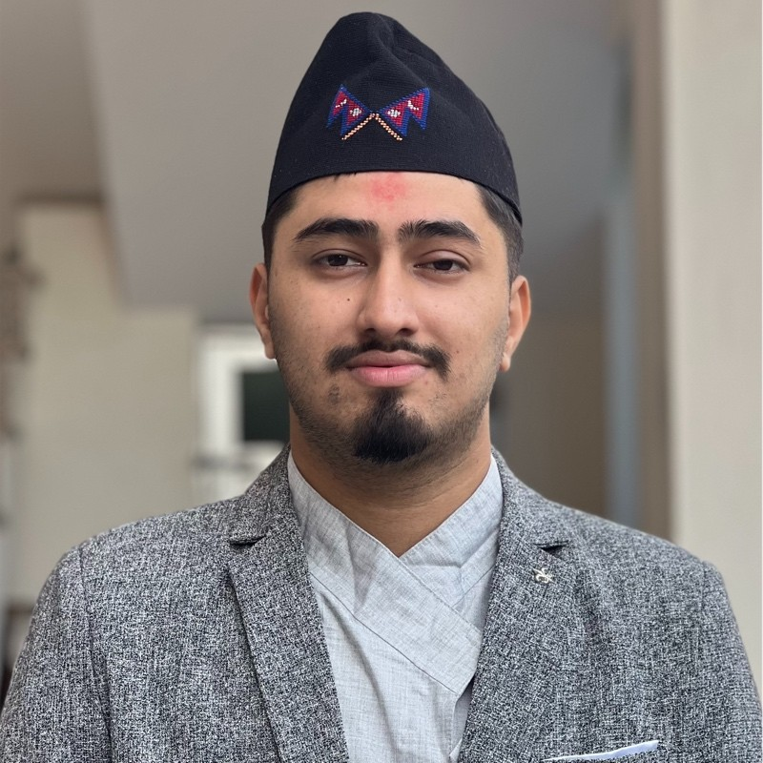
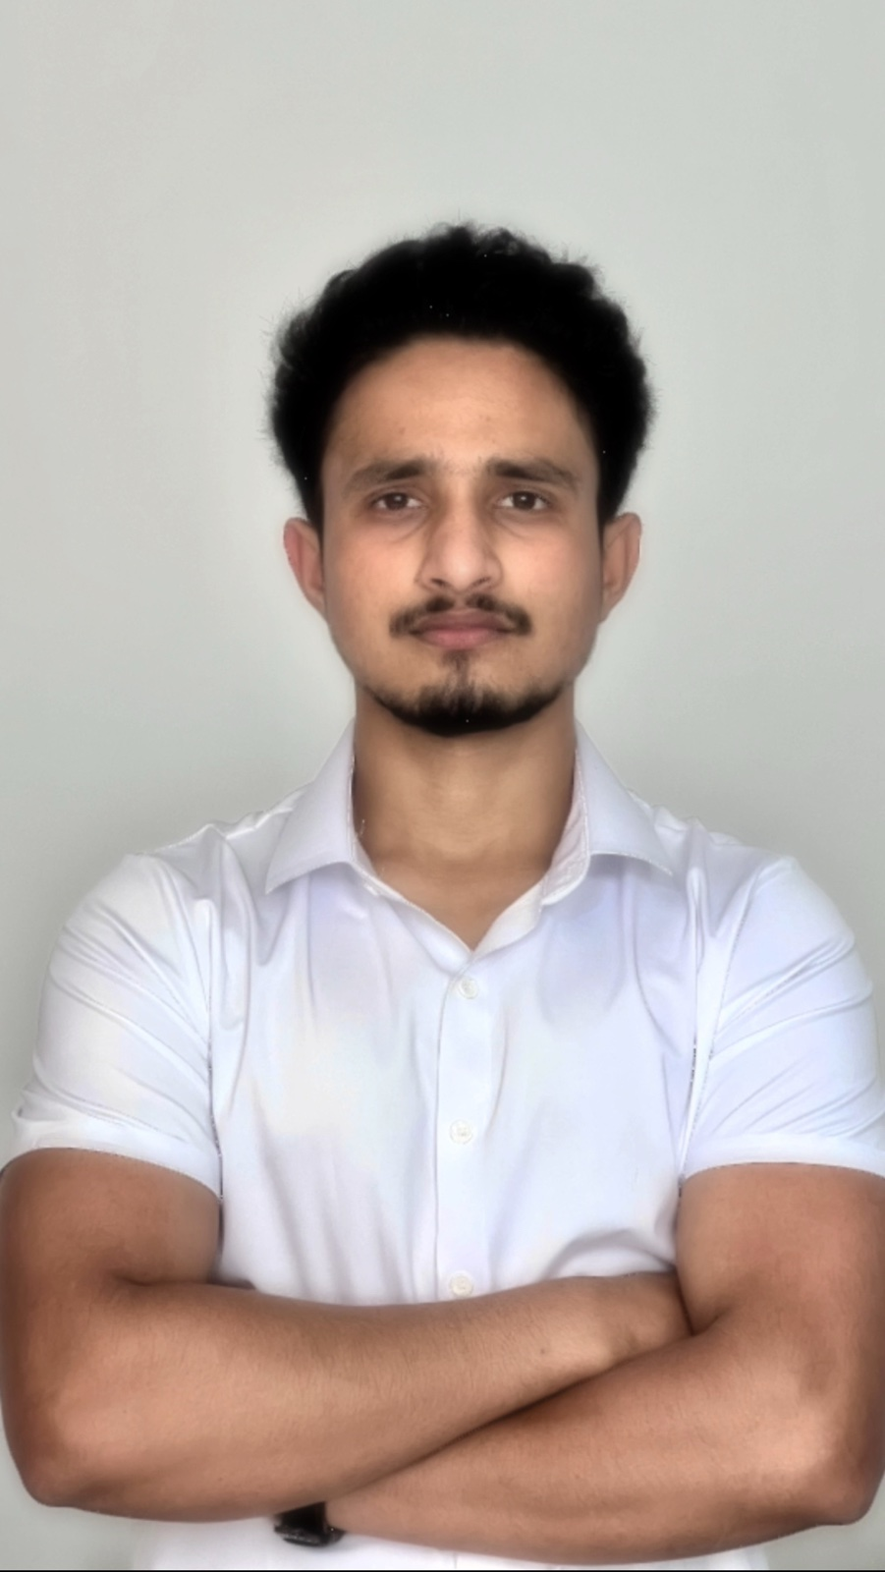
Instructors
Pujan Pant
Piyush Phuyal
BSC(Honors) in Computer Science
BSC(Honors) in Computer Science
University of Wolverhampton
University of Wolverhampton
Research Interest: AI in Transportation
Research Interest: AI in Agriculture
25th May,2025

Slide 2
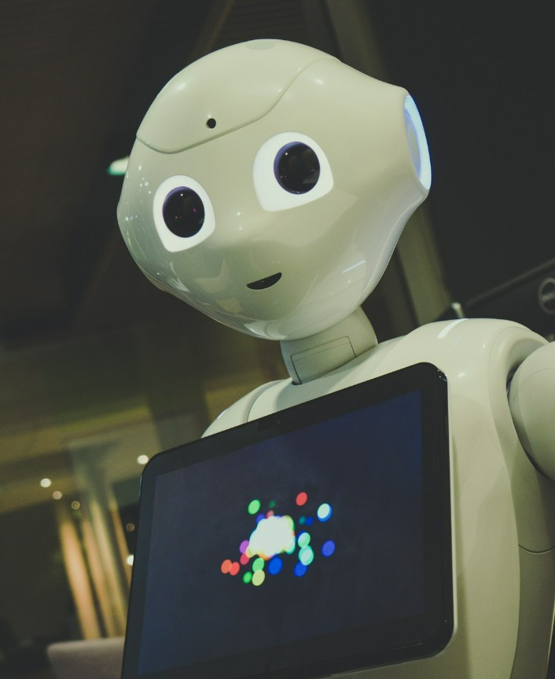
“AI and Applications of AI”
Course Highlights
Comprehensive Python Foundation
Foundational Math and Stats for AI
Practical Machine Learning Implementation
Introduction to Deep Learning

Slide 3
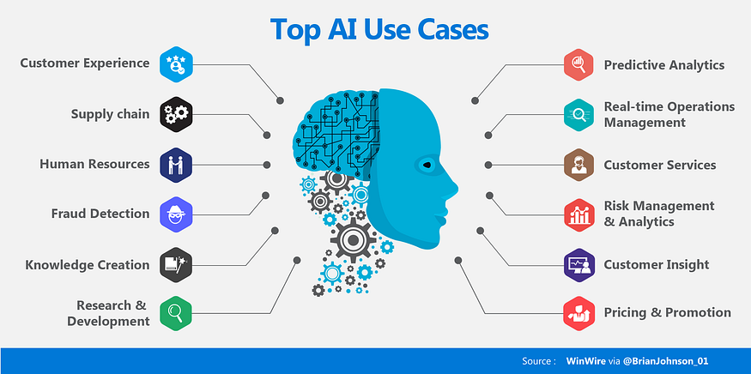
AI Applications Across Sectors

Slide 4
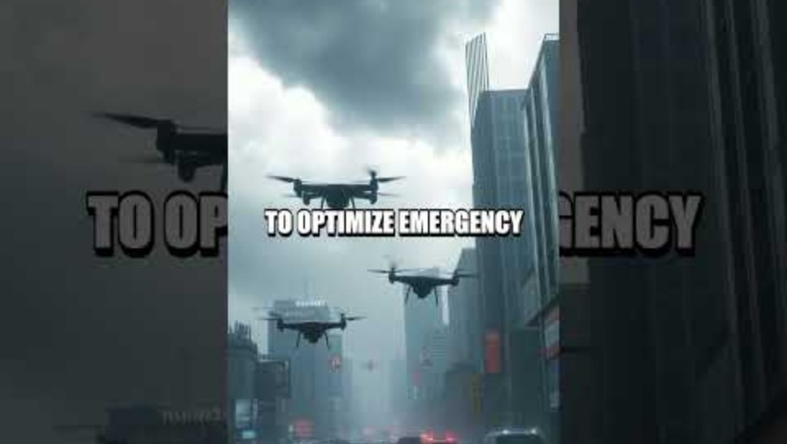
AI in Action – Transforming Lives

Slide 5

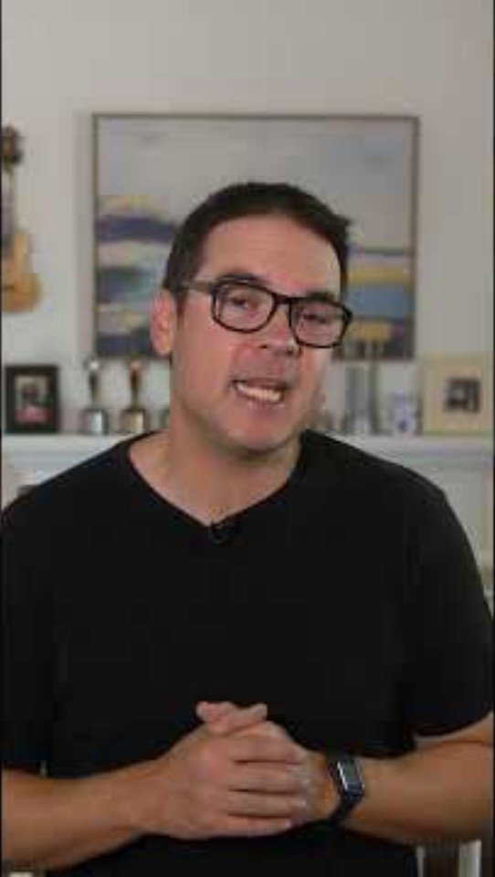
Live Demos – Seeing is Believing

Slide 6
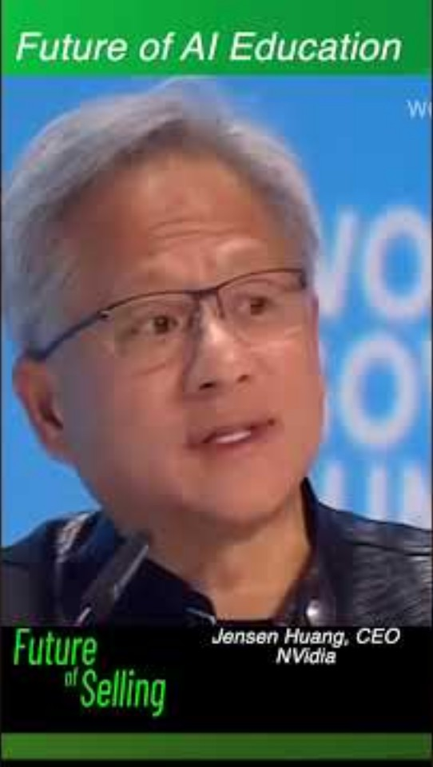
The AI Dream – Motivation for the Next Generation
"AI will not replace you. A person using AI will."

Slide 7
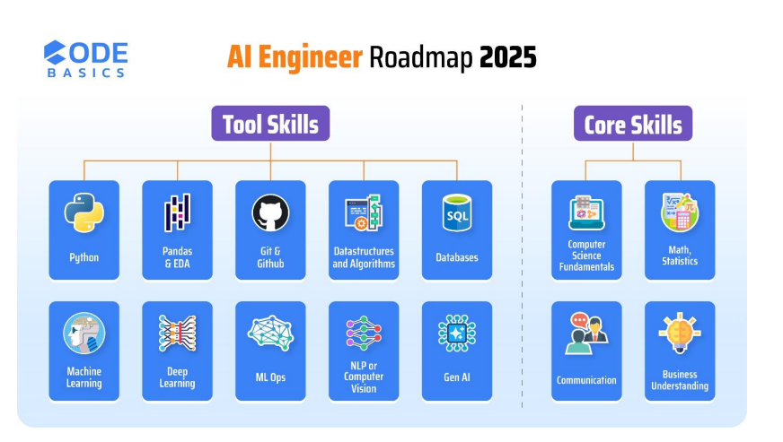
RoadMap of AI(Engineer)

Slide 8
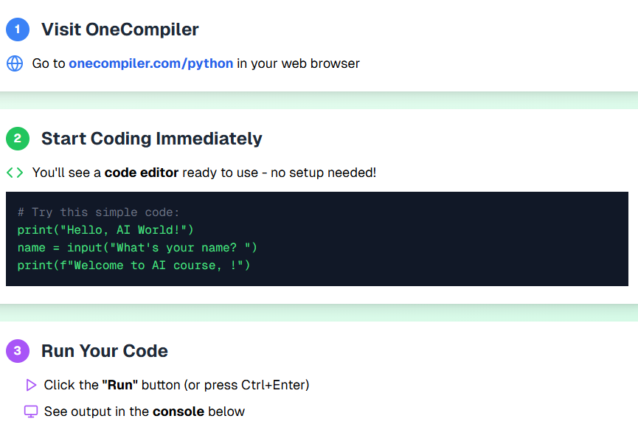
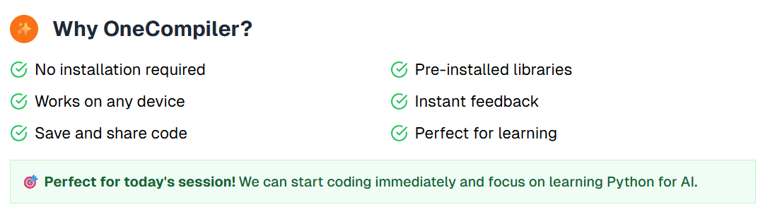
Python Environment & Setup
For the next few sessions, we will be using OneCompiler for our coding exercises. Google Colab will be used in the coming days. You can directly access OneCompiler by typing 'OneCompiler' into your web browser and selecting 'Python‘.

Slide 9
QnA
And
Feedback

